Slide 1
Cole History day
Parent Meeting
Thursday, September 28, 2023

Slide 2
What is History Day?
Based on a given theme, students (4th-6th) research and then present their findings within given categories
Elementary Division: 4th & 5th
Poster
Podcast
Jr Division: 6th
Exhibit
Documentary
Performance
Website
Podcast
Paper
Students compete at the school level and depending on that performance, may compete at county, state and national level (Elementary Division and Podcasts excluded)
Block C point for ‘Mind: Academic Challenge’

Slide 3
General Information
Theme: “Turning Points in History”
Cole History Day
TBD (2nd or 3rd week in December)
Entries can be completed individually or as a group (up to 5 students within the same division)
Every entry must include a title page, process paper, and annotated bibliography
Weekly meetings to monitor progress
Every Wednesday at 7:20 am in room 21
Hard copies of hand-outs will be given
Parents/students will be emailed PowerPoints for that week that will contain links to resources
Please make arrangements to get hand-outs/information if you are not able to attend a meeting

Slide 4
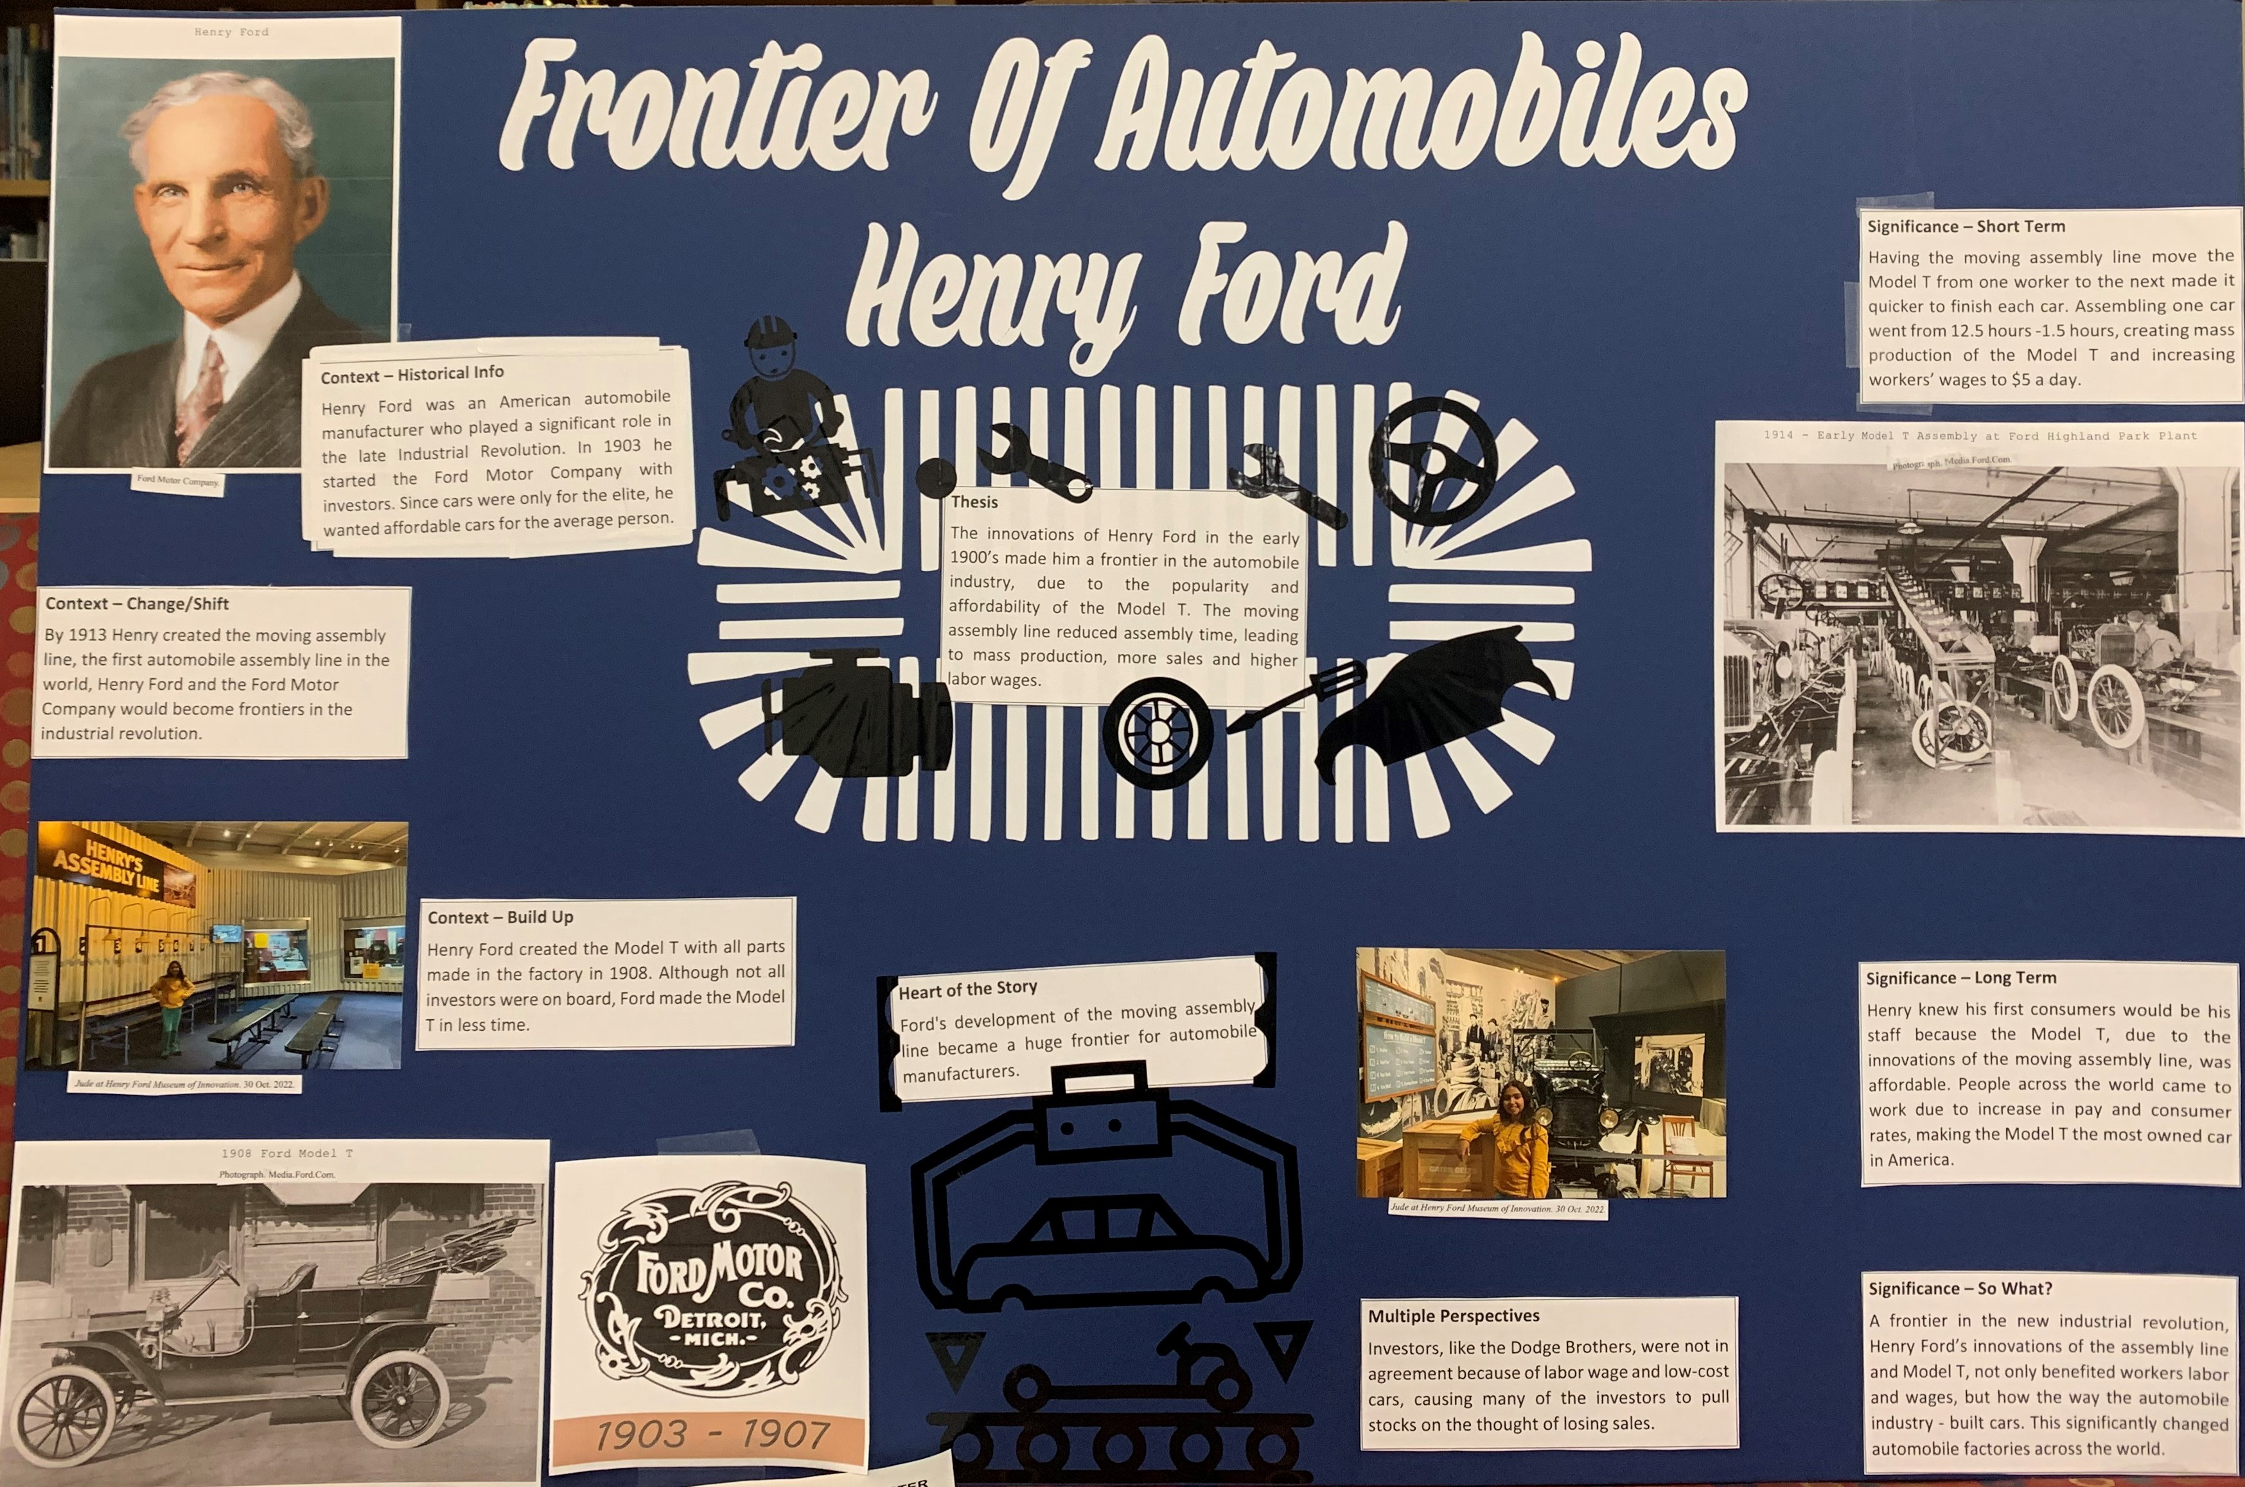
Elementary Division Posters
Group Poster
Individual Poster

Slide 5
Jr Division Entries
Junior Division – Individual Exhibit

Slide 6
Additional competitions:
Fresno County (FPU)
March 9, 2024
State Competition (CSU Sacramento)
April 19 – 21, 2024
National Competition (University of Maryland)
June 9 – 13, 2024

Slide 7
Topic Ideas:
https://youtu.be/9WLhlGVuW5c?si=zbbHCbUY1zGRfZBL
Websites to help with topic ideas:
https://www.docsteach.org/topics/nhd
https://edsitement.neh.gov/teachers-guides/preparing-national-history-day
https://pickingatopic.weebly.com/categories.html
** Use student’s interest to help guide the topic chosen ☺ **

Slide 8
Additional Information:
Fresno County History Day website
https://historyday.fcoe.org/
California History Day website
https://www.nhdca.org/
National History Day website
https://nhd.org/en/
** Rule Book: https://www.nhdca.org/contest-rules/

Slide 9
Advisor Information:
Christina Smith
christinasmith@cusd.com
327-6200 ext. 76221

Slide 10
Questions/Comments

